Slide 1
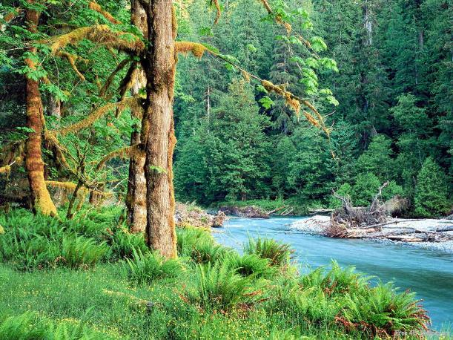
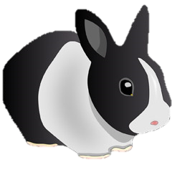
Warm Up 3/1/2016
Describe a rabbits habitat.

Slide 2
Ecological Succession

Slide 3
Objectives
Describe succession with 80% accuracy utilizing class materials.
Describe the difference between primary and secondary succession with 80% accuracy utilizing class materials.

Slide 4
Review
What is a habitat?
A place where organism’s live
What is a population?
A group of individuals of the same species in a particular location
What is a community?
All of the populations of a species in a given area
What is an ecosystem?
The community (abiotic and biotic) including the Earth’s atmosphere

Slide 5
Ecological Succession
What is ecological succession?
The gradual process by which ecosystems change and develop over time
Nothing remains the same forever
Habitats are constantly changing

Slide 6
Flare it Up!
In groups of three, you will use color to display the important parts of your given slide.
Add any relevant information from the textbook to help.
Use certain colors to emphasize vocabulary, key points, etc. Provide images to help visualize points.
Your work will be the notes for the class!
You will have 7 minutes to complete this.

Slide 7
Ecological Succession
There are two main types, primary and secondary
Primary Succession
The series of community changes which occur on an entirely new habitat
For example: after a volcano erupts primary succession will occur

Slide 8
Ecological Succession
There are two main types, primary and secondary
Secondary Succession
The series of changes which take place on a previously colonized, but disturbed or damaged habitat
For example: a dead tree

Slide 9
Succession Timescales
Succession can occur on many different timescales
Timescales can range from a few days to hundreds of years
For example:
Succession in a cow pie (pile of cow poop) takes about 3 months
Succession in a woodland may take hundreds of years

Slide 10
Why does succession occur?
The environment does not remain the same forever
As the environmental conditions change over time succession occurs
Each species is adapted to survive, thrive, and compete best against other species under a very specific set of environmental conditions
The succession of plants controls the succession of animals

Slide 11
Plants are in control
Changes in the plant species in an area is the driving force behind the changes in animal species.
Each plant species will have an animal that feeds on it. As these plants change the animals will then change along with it

Slide 12
Pioneer Plants
Pioneer plant species are species that grow best where there is little competition for space and resources
Bare ground is the ideal location for the establishment of pioneer plants
Pioneer plants are typically small and low to the ground such as moss and algae
Pioneer plants mainly grow in primary succession areas

Slide 13
Primary vs. secondary
Primary succession occurs in an area that has never been colonized
For example:
As part of the natural sequence of life, trees mature and eventually die. When they fall to the ground, an opening is provided in the land and the process starts all over again on that new opening.
The species which colonize the opening will be different than the original bare ground pioneers because the environmental conditions have been altered
There is a different starting point

Slide 14
Primary vs. secondary
Secondary succession occurs in an area that has previously been colonized but is damaged
For example:
As part of the natural sequence of life, trees mature and eventually die. When they fall to the ground, an opening is provided in the land and the process starts all over again on that new opening.
The species which colonize the opening will be different than the original bare ground pioneers because the environmental conditions have been altered
There is a different starting point

Slide 15
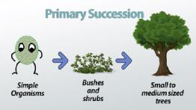

Slide 16
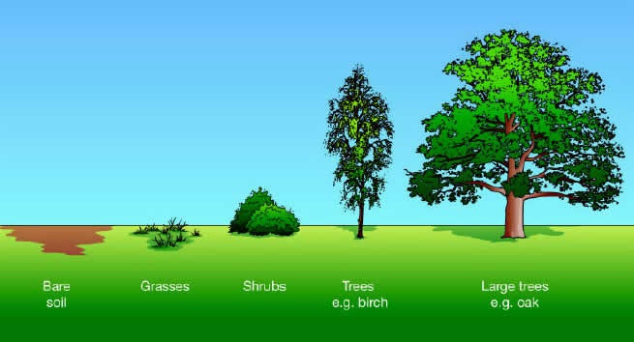

Slide 18
Secondary Succession
Much quicker than primary succession
There are suitable seeds in the soil
Remaining plant parts (stumps, roots, etc.) can rapidly regenerate
Fertility and structure has already been modified by organisms to make it more suitable for growth and colonization

Slide 19
Video/Game

Slide 20
Ecology Relationships

Slide 21
Objectives
Describe possible ecological relationships between species that live in close proximity to each other with 80% accuracy utilizing class materials.
Define symbiotic relationships as mutualistic, parasitic, or commensalistic with 80% accuracy utilizing class materials.
Classify symbiotic relationships with 80% accuracy utilizing class materials.

Slide 22
Look at the words on the board
Brainstorm what types of ecological and symbiotic relationships you think the terms describe

Slide 23
Vocabulary
Competition – when two or more organisms rely on the same environmental resources
Predation – behavior of one animal feeding on another
Symbiosis – the close relationship of two dissimilar organisms
Mutualism – a symbiotic relationship where both organisms benefit
Commensalism – a symbiotic relationship where one organism benefits and the other does not benefit but is unharmed
Parasitism – a symbiotic relationship where one organism benefits and one is harmed

Slide 24
National Geographic
http://education.nationalgeographic.org/activity/ecological-relationships/

